Slide 1
REVIEW 2 · THE PROTOTYPE
A working web app on a working API
Frontend prototype | RUNNING · 7 routes, 4 roles, 1 of 5 screens on live data
API | 33 endpoints, JWT auth, role guard on every route
Database | MongoDB · schema, scripts, sample data, queries done
3,419 lines · 16 components · 7 routes · 14 runtime dependencies
Notes:
The prototype is partly wired: the dashboard is live, while four other screens are not yet. The API has 33 endpoints, JWT auth and a role guard on every route; the database work is complete.

Slide 2
HOW THE PIECES FIT
One origin, no CORS
Browser
FastAPI
MongoDB
→ React SPA
Vite dev server :5173
fetch /api/* ↓
:8000 · pure JSON API
replica set rs0
Vite proxies /api to :8000, so the browser sees one origin.
There is no CORS middleware anywhere; FastAPI serves only JSON and its own Swagger docs.
Development setup only: production would serve built assets behind, or alongside, the API.
Build: tsc -b && vite build; a TypeScript error fails the build.
REVIEW 1 WAS THE DESIGN. THIS IS THE BUILD.
2
Notes:
The key architectural decision is the Vite proxy: the browser only sees one origin, which removes CORS configuration entirely. This is the development setup and the app has not been deployed; production would preserve the same effect by serving built assets behind, or alongside, the API.

Slide 3
FRAMEWORK CHOICES
Fourteen dependencies, each earning its place
React 19.2 + TypeScript | component model; types catch prop and API-shape mistakes at build time
Vite 8 | dev server with HMR; production build in ~270 ms
Tailwind CSS 4 | utility-first; design system is CSS custom properties, not a config file
React Router 7 | client-side routing with nested layout routes
Framer Motion · Radix UI | animation · accessible primitives: dialog, label, slot
Lenis · lucide-react | smooth scroll, landing page only · one icon set
Dropped a second icon library: every icon existed in lucide-react; two sets were not worth ~500 KB.
Dropped a WebGL shader library: one button was rebuilt with Framer Motion at zero dependency cost.
No Redux or state library: one React context plus local state covers everything.
REVIEW 1 WAS THE DESIGN. THIS IS THE BUILD.
3
Notes:
Each dependency earns its place, and two deliberate rejections keep the stack smaller. There is no Redux: one React context plus local state covers the app.

Slide 4
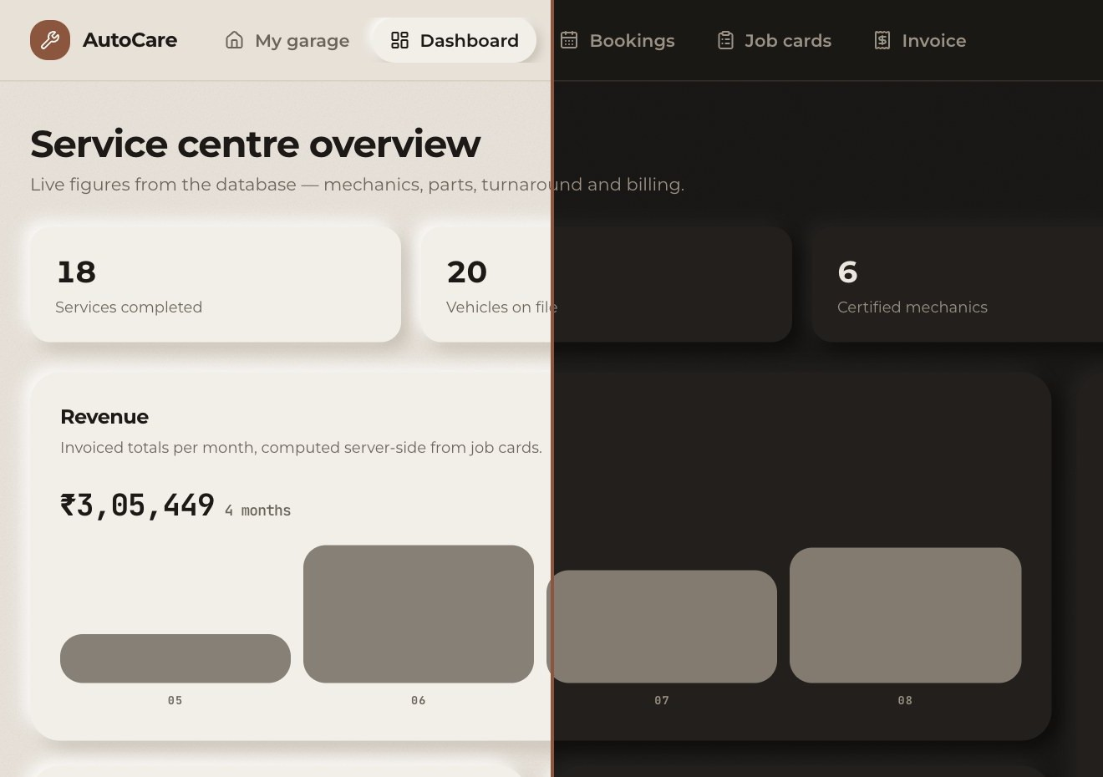
INTERFACE
Warm-neutral neomorphism, built from tokens
Montserrat for text · JetBrains Mono for data
Bone and clay palette · 66 CSS custom properties
.neo raised · .neo-sm subtler · .neo-inset pressed · .neo-flat barely raised · .neo-press swaps on :active · .shimmer loading skeleton
Surfaces stay mid-tone: neomorphism needs a highlight and a shadow; pure white kills the effect.
Paper grain sits on body::before only, behind controls.
Dark mode re-declares tokens under .dark and inverts the shadow pair; both themes are implemented.
prefers-reduced-motion disables animation.
SAME SCREEN · LIGHT LEFT, DARK RIGHT · TOKENS RE-DECLARED UNDER .DARK
REVIEW 1 WAS THE DESIGN. THIS IS THE BUILD.
4
Notes:
This is deliberately not the default framework look: no Inter, no blue and no decorative gradients. The interesting constraint is that mid-tone surfaces must preserve both sides of the shadow pair. Both themes are implemented, and reduced motion disables animation.

Slide 5
STRUCTURE
Pages own data; components take props
16 components: 14 presentational in components/ui, plus AppShell and ProtectedRoute. 7 page components.
/ · /auth | public · landing; sign in / register
/app · /app/dashboard | signed in · my garage; staff · reports
/app/bookings · /app/jobs | staff · calendar; workshop · job cards
/app/invoice | signed in · payment
7 routes use nested layout routes.
Components never fetch on their own; the reports panel receives <ReportsBento data={data} />.
Pages fetch data, so fixtures could become live API data without touching a chart.
REVIEW 1 WAS THE DESIGN. THIS IS THE BUILD.
5
Notes:
The composition rule is simple: pages own data and components take props. That separation is why the dashboard could swap fixtures for live API data without touching a single chart.

Slide 6

SECURITY · THE CLIENT SIDE
The route guard is not the security boundary
Sign in → POST /api/auth/login returns a JWT and the user.
Store it in localStorage under autocare.token; it expires in 12 h.
api() attaches a bearer header and clears it on a 401.
AuthProvider calls /auth/me on load; ProtectedRoute redirects to /auth, remembers the destination, or shows “not available to your role”.
Roles: customer · receptionist · mechanic · manager. Customer sees two links; manager sees five.
Hiding a route protects nothing. The API checks role on every endpoint and ownership on customer reads: another customer's job card gets the same 404 as a missing one.
Fixed: role was checked but ownership was not, so a customer could read anyone's job card. Now 404, covered by 7 tests.
Weakness: JWT in localStorage is exposed to XSS; an httpOnly cookie would not be.
Weakness: any /auth/me failure reads as “signed out”; the token survives and reload restores the session.
REVIEW 1 WAS THE DESIGN. THIS IS THE BUILD.
6
Notes:
The route guard is a user-experience boundary, not the security boundary. Every API endpoint is guarded server-side. I would also volunteer the two weaknesses: localStorage exposes the JWT to XSS, and a network failure at /auth/me looks like sign-out until the API returns.

Slide 7
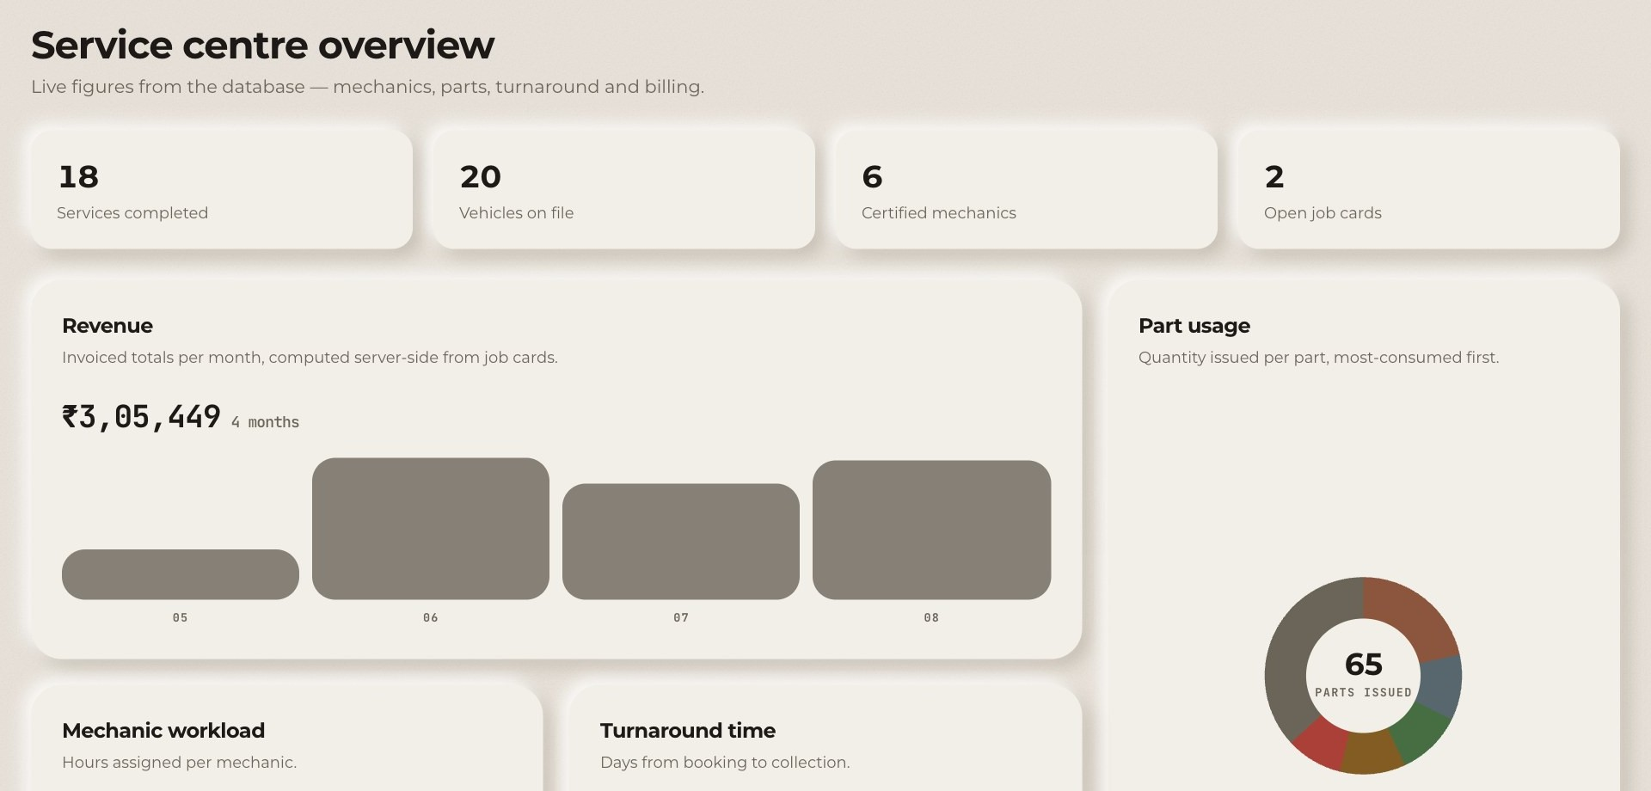
DATA FETCHING
Seven requests, one pass, three states
7
dashboard report requests with Promise.all
Sequential awaits would cost the sum of all seven. A cancelled flag prevents a late response setting state after unmount.
loading · skeleton sweeps left to right with .shimmer
error · backend's own message is shown
empty · each panel has its own “no data yet” state
SIGNED IN AS MANAGER · EVERY FIGURE COMES FROM THE SEEDED DATABASE
Dashboard | LIVE
Bookings · Job cards · Invoice · My garage | fixture data
The other four need new endpoints first: job-card list, invoice reads, a customer's own vehicles, and bookings enriched with registration number and customer name.
REVIEW 1 WAS THE DESIGN. THIS IS THE BUILD.
7
Notes:
The dashboard is the live screen and fires seven report requests in parallel. The other four screens remain fixture-backed because their required endpoints do not exist yet. Loading, error and empty are all explicit states.

Slide 8
THE BACKEND, BRIEFLY
Correctness lives below the interface
FastAPI + MongoDB on a single-node replica set (required for transactions) · 12 collections · 245 seeded documents · 33 endpoints · 28 tests passing, including a concurrent race for the last unit of stock.
13-entity conceptual diagram → 14-table physical one.
no overlapping mechanic assignment | 409 · names the conflicting assignment
issue a part beyond stock | 409 · quotes the SKU and stock on hand
invoice carrying a client total | 422 · field rejected; totals are computed
report with no token | 401
user list as a receptionist | 403
All five matched on a fresh run. The UI must turn these into something actionable.
The “part issue failed” toast is a SIMULATION driven by fixture stock, not the real API. The real 409 is shown through Swagger at /docs; wiring it into that screen is next.
REVIEW 1 WAS THE DESIGN. THIS IS THE BUILD.
8
Notes:
This is the only database slide. The frontend depends on business rules reaching it as HTTP status codes: 409, 422, 401 and 403. All five checks matched on a fresh run, but the job-card toast is still a fixture simulation; the real 409 is visible in Swagger at /docs.

Slide 9
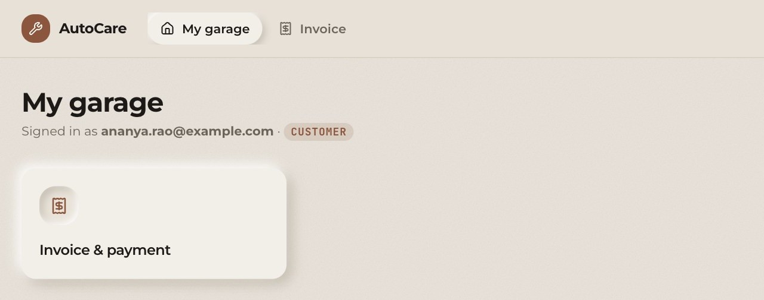
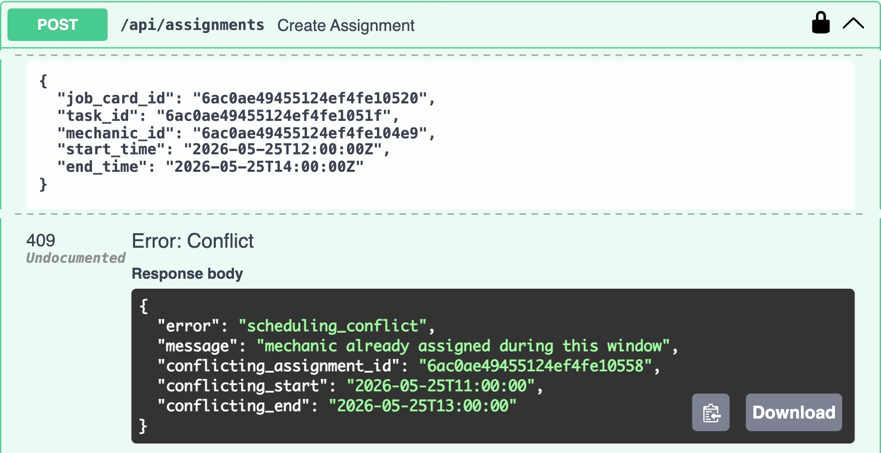
WHAT YOU WILL SEE
A walk through the running app
Landing page: smooth scroll, FAQ accordion, track-your-car form; it sends visitors to sign-in but does not yet use the number typed in.
Sign in as customer: two navigation links only.
Type /app/dashboard directly: blocked, “not available to your role”.
Sign out, sign in as manager: five links and seven live dashboard requests.
Toggle dark mode: the whole shadow system inverts.
Open Swagger at /docs and send the overlapping assignment: 409.
Four demo logins, one per role, all password autocare123, click-to-fill: manager · receptionist · mechanic · customer.
STEP 2 · A CUSTOMER GETS TWO LINKS: MY GARAGE, INVOICE
STEP 6 · REAL 409 FROM THE API · NOTHING IS WRITTEN
REVIEW 1 WAS THE DESIGN. THIS IS THE BUILD.
9
Notes:
Step 6 is the API, not the UI, because the assignment screen does not exist yet. The runbook demonstrates role-aware navigation, the client guard, live dashboard data, dark mode and the real 409 response in Swagger.

Slide 10

STATUS · REVIEW 3 AHEAD
Three real bugs, and an honest list of gaps
BUG 1 — animation blocked a state transition
4 of 5 screens still use fixture data.
No frontend tests: no Vitest, no Testing Library; backend has 28.
JS bundle 533 kB (166 kB gzipped), over Vite's 500 kB warning; no code-splitting.
10 lint warnings, none breaking.
Accessibility: contrast tokens recalculated and <main> added; Lighthouse 100 on landing and sign-in. Signed-in screens not yet audited.
Landing figures “12,400+ services” and “4.8 / 5” are placeholder marketing copy; track-your-car discards the registration number.
AnimatePresence with mode="wait" held the next component until the previous exit finished; Pay left the form indefinitely. Fix: plain conditional. Lesson: never gate a transition behind animation finishing.
BUG 2 — an effect that could never fire
useEffect synced props into state, but parent key={id} remounted it. Fix: deleted. Lesson: key already resets state.
BUG 3 — role checked, ownership not
Any customer could read anyone's job card. Fix: check the owner; not yours → 404, same as missing. Lesson: a role is not a permission.
Review 3: wire four screens; build vehicle-registration, mechanic-assignment and parts screens; add route-level code splitting; test auth guard and reports hook.
Please test whether each role, and each customer, sees only what is theirs: in the interface and directly against the API.
REVIEW 1 WAS THE DESIGN. THIS IS THE BUILD.
10
Notes:
The two bugs show understanding of React's model: mode="wait" delayed mounting, while key={id} already remounted the component. The gaps are explicit, and Review 3 is about wiring the remaining screens, the missing screens, code splitting and tests. The question I would like you to test is whether the interface can be trusted to show only what each role is allowed to see.

